Slide 1
Mentor Session 3
Linear Regression
TensorFlow
TF code example for LR

Slide 2
TensorFlow-CPU Installation in Anaconda
Open Anaconda Prompt
To create a new environment with a specific version of Python: conda create –n tensorflow python=3.7
Activate the environment: (conda) activate tensorflow
To install Tensorflow-cpu: conda install –c conda-forge tensorflow
To run the code: python xxxx.py
To deactivate the environment:
For GPU version TensorFlow:
https://blog.csdn.net/linhai1028/article/details/79233311 (Ubuntu)
https://zhuanlan.zhihu.com/p/37086409 (Windows)

Slide 3
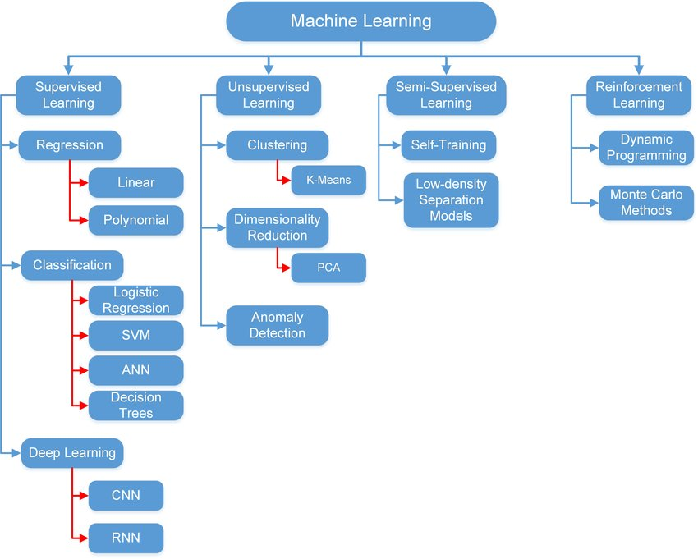

Slide 4
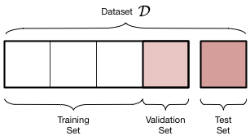
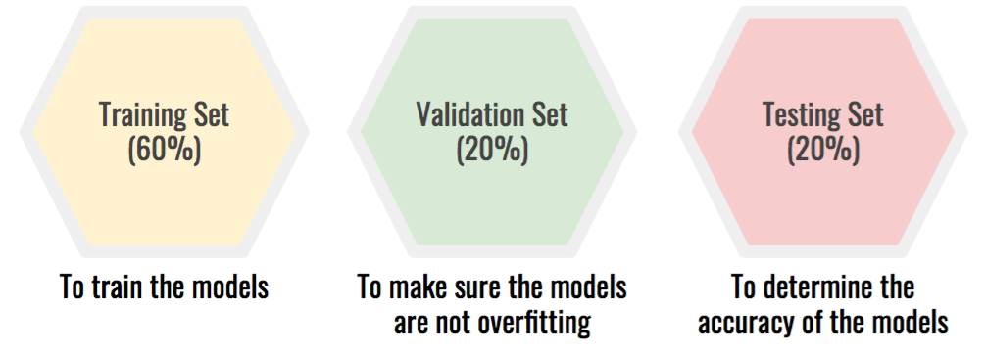
Training, Validation and Testing Dataset
Training data is a set of examples used to fit the parameters.
Validation dataset provides an unbiased evaluation of a model fit on the training dataset while tuning the model's hyper-parameters
Test dataset is a dataset used to provide an unbiased evaluation of a final model fit on the training dataset

Slide 5
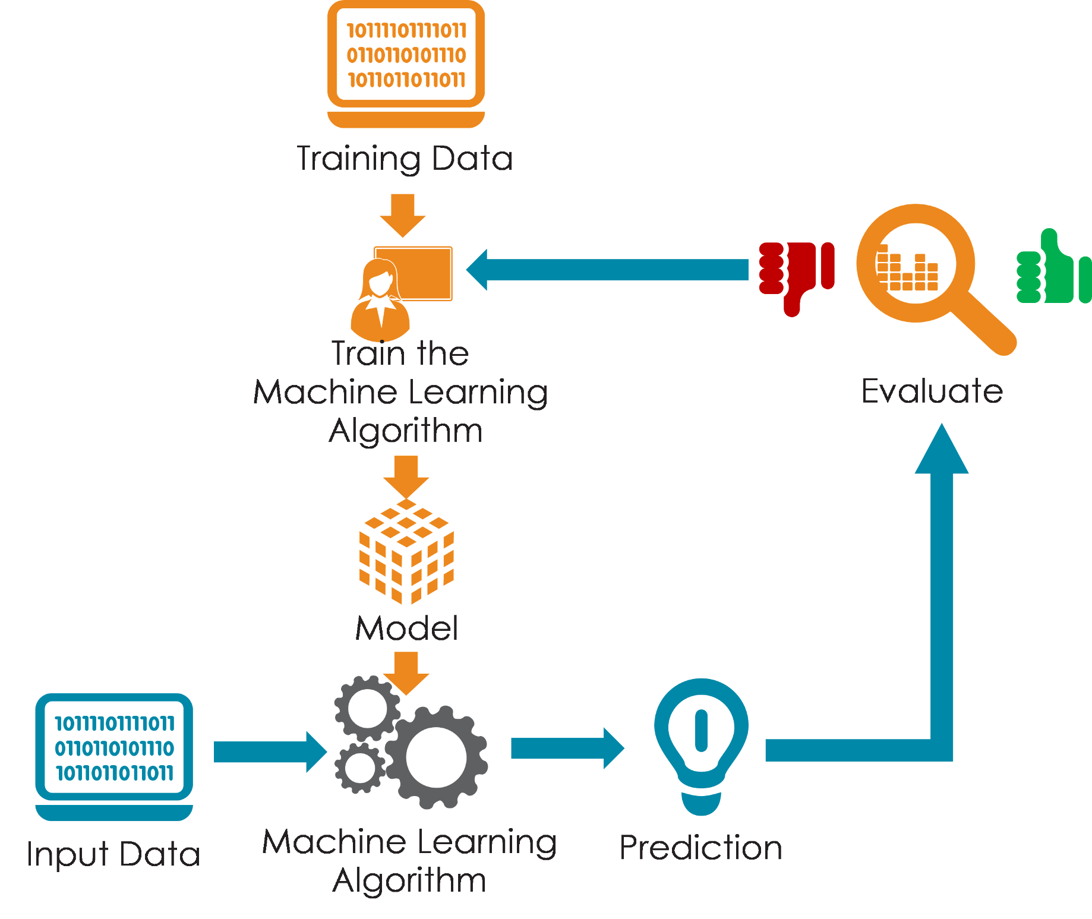
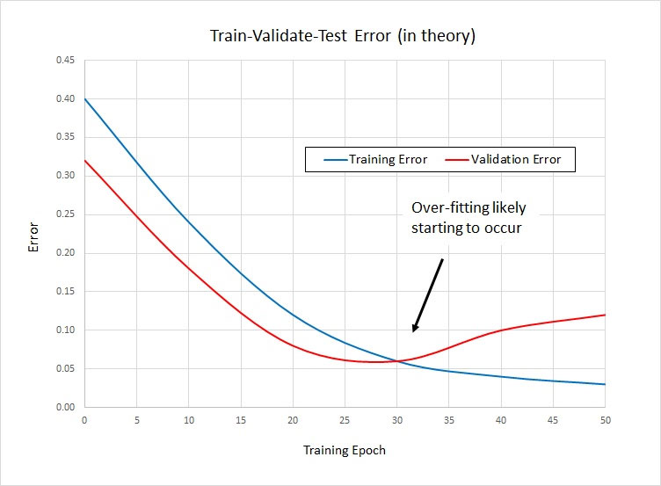

Slide 6


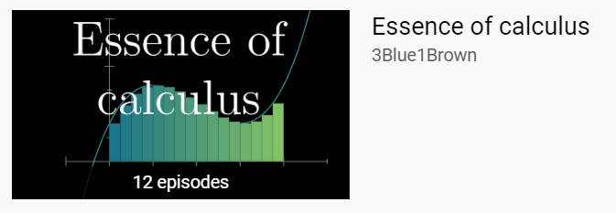
YouTube 3Blue1Brown

Slide 7
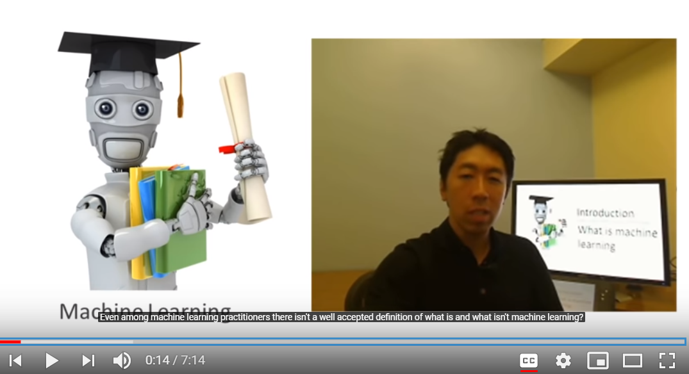
YouTube: Machine Learning | Andrew Ng

Slide 8
Download Academic Papers
1. Search it in Google Scholar: https://scholar.google.com/
2. Open the webpage, and copy the website
3. Find it in SCI-Hub: https://sci-hub.tw/

Slide 9
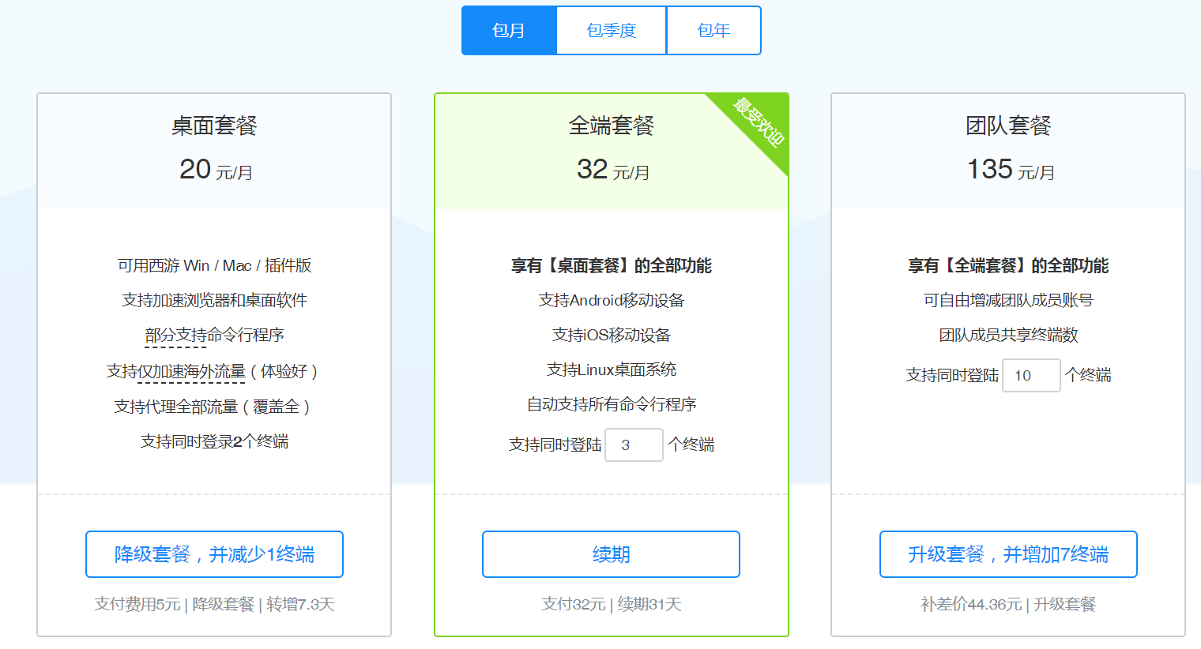
Scientific Internet (Flip the wall)
https://xiyou4you.us/r/?s=12491373
Google
Google Scholar
YouTube

